Slide 1
Enhanced ER Model
Dr. S. RENUKA DEVI
Associate Profesor
SCSE
VIT Chennai Campus

Slide 2
Enhanced ER Model
It is an extension to the ER modeling that incorporates the concept of semantic data modelling
Created to design more accurate database schemas
It includes
Subclass and Superclass
Specialization and Generalization
category or union type
Attribute and relationship inheritance

Slide 3
Subtypes, Supertypes and Inheritance
Subtype or Subclass
Subgroupings of entities that are meaningful
Represented explicitly because of their significance to the database application
Supertype - An generic entity type that has a relationship with one or more subtypes
Inheritance
Subtype entities inherit values of all attributes of the supertype
An instance of a subtype is also an instance of the supertype

Slide 4
Specialization
It is the process of defining a set of subclasses of an entity type; this entity type is called the superclass of the specialization
Defined on the basis of some distinguishing characteristic of the entities in the superclass
E.g,, set of subclasses {SECRETARY, ENGINEER, TECHNICIAN} is a specialization of the superclass EMPLOYEE
Distinguishing characteristics - job type
It is also possible to have several specializations of the same entity type based on different distinguishing characteristics

Slide 5
Specialization (contd…)
Subclasses that define a specialization are attached by lines to a circle that represents the specialization, which is connected in turn to the superclass
subset symbol on each line connecting a subclass to the circle indicates the direction of the superclass/ subclass relationship
Attributes that apply only to entities of a particular subclass are attached to the rectangle representing that subclass. These are called specific attributes (or local attributes)

Slide 6
IS-A Relationship
The relationship between a superclass and any one of its subclasses is called superclass/subclass or supertype/ subtype or simply class/subclass relationship
A class/subclass relationship is often called an IS-A (or IS-AN) relationship
E.g., SECRETARY is an EMPLOYEE, a TECHNICIAN is an EMPLOYEE, and so on

Slide 7
Type Inheritance
An entity that is a member of a subclass inherits all the attributes of the entity as a member of the superclass
It also inherits all the relationships in which the superclass participates
A subclass, with its own specific (or local) attributes and relationships together with all the inherited attributes and relationships can be considered an entity type in its own right

Slide 8
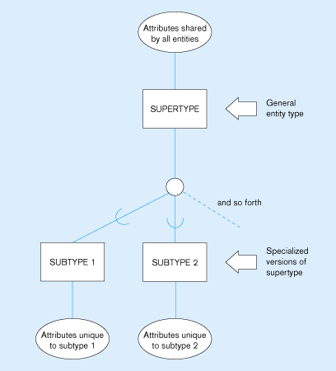
Specialization

Slide 9
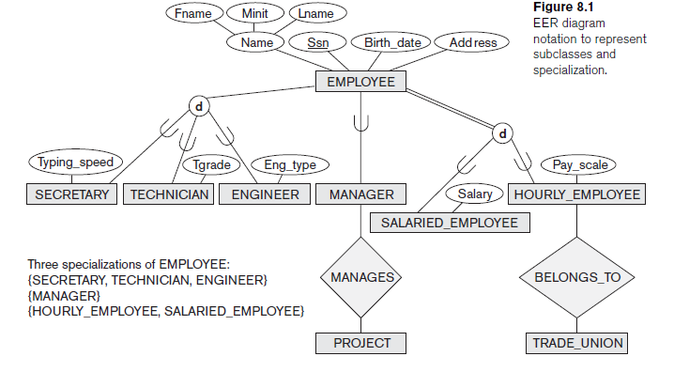

Slide 10
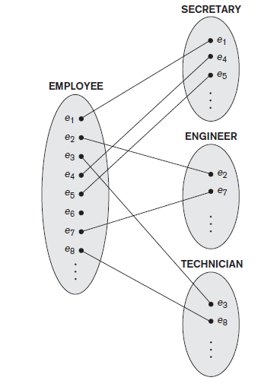
Instances of Specialization

Slide 11
Generalization
It is a reverse process of abstraction
It suppress the differences among several entity types, identify their common features, and generalize them into a single superclass
Original entity types are special subclasses
Generalization refers to the process of defining a generalized entity type from the given entity types

Slide 12
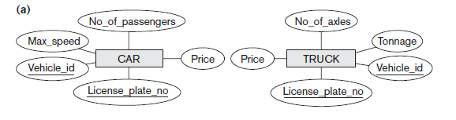
Generalization (contd…)
(a) Two entity types, CAR and TRUCK

Slide 13
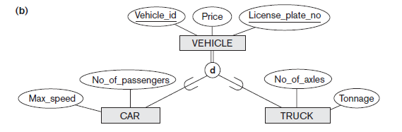
Generalization (contd…)
(b) Generalizing CAR and TRUCK into the superclass VEHICLE.

Slide 14
Constraints on Specialization and Generalization
a specialization may consist of a single subclass only, such as the {MANAGER} specialization in Figure 8.1; in such a case, we do not use the circle notation
Determining the members of each subclass by placing a condition on the value of some attribute of the superclass - predicate-defined (or condition-defined) Subclasses
If all subclasses in a specialization have their membership condition on the same attribute of the superclass - attribute-defined specialization
the attribute is called the defining attribute of the specialization

Slide 15
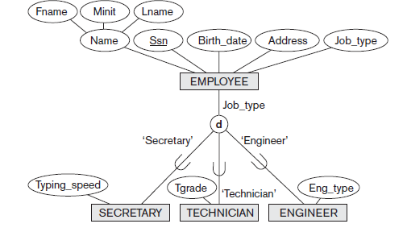
Attribute –defined Specialization

Slide 16
Disjointness Constraint
Specifies that the subclasses of the specialization must be disjoint - an entity can be a member of at most one of the subclasses of the specialization
A specialization that is attribute-defined implies the disjointness constraint
In EER diagrams, d in the circle stands for Disjoint
If the subclasses are not constrained to be disjoint, then sets of entity may be overlapping

Slide 17
Completeness or Totalness Constraint
May be total or partial
A total specialization constraint specifies that every entity in the superclass must be a member of at least one subclass in the Specialization
It is shown in EER diagrams by using a double line to connect the superclass to the circle
A partial specialization allows an entity not to belong to any of the subclasses
It is shown in EER diagrams by using a single line

Slide 18
Constraints
Disjointness and completeness constraints are independent
Four possible constraints on specialization
Disjoint, total
Disjoint, partial
Overlapping, total
Overlapping, partial

Slide 19
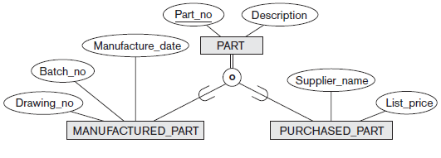
Overlapping Specialization

Slide 20
Some of the Insertion and deletion rules
Deleting an entity from a superclass implies that it is automatically deleted from all the subclasses to which it belongs
Inserting an entity in a superclass implies that the entity is mandatorily inserted in all predicate-defined (or attribute-defined) subclasses for which the entity satisfies the defining predicate
Inserting an entity in a superclass of a total specialization implies that the entity is mandatorily inserted in at least one of the subclasses of the specialization

Slide 21
Any Queries?

